Slide 1




Excel
Training
for Beginners
SAID FAWZY
Manager of Information Center
Tendering Department
Arab Contractors

Slide 2


Excel
Training
for Beginners
SAID FAWZY
9
Printing Worksheets

Slide 3






90%
90%
Setting Margins and Orientation
Setting and Clearing the Print Area
Inserting Page Breaks
Print Titles and a Background
Headers and Footers

Slide 4
90%
90%
Printing a Workbook
Exam 9: Printing Worksheets

Slide 5
Excel
Training
for Beginners
SAID FAWZY
Setting Margins and Orientation
1

Slide 6
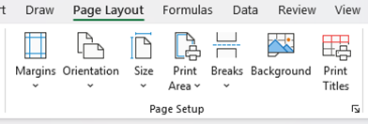
Setting Margins and Orientation
Page Setup Group

Slide 7
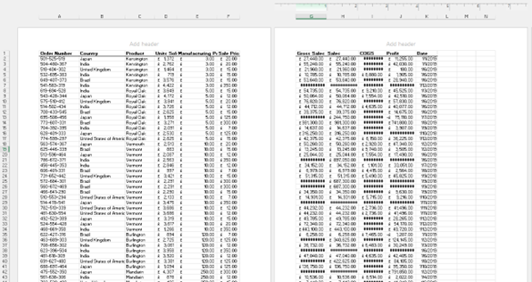

Setting Margins and Orientation
Margins

Slide 8
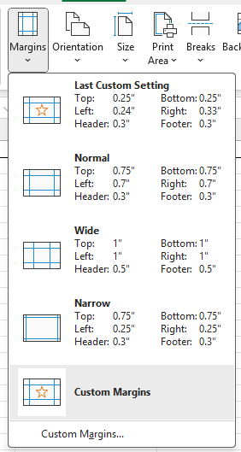
Setting Margins and Orientation
Margins

Slide 9
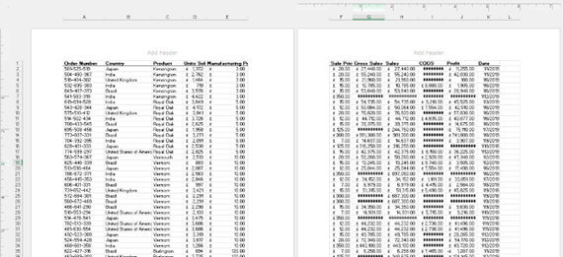
Setting Margins and Orientation
Margins (wide)

Slide 10
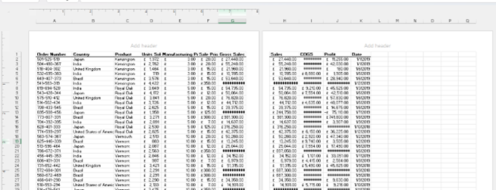
Setting Margins and Orientation
Margins (Narrow)

Slide 11
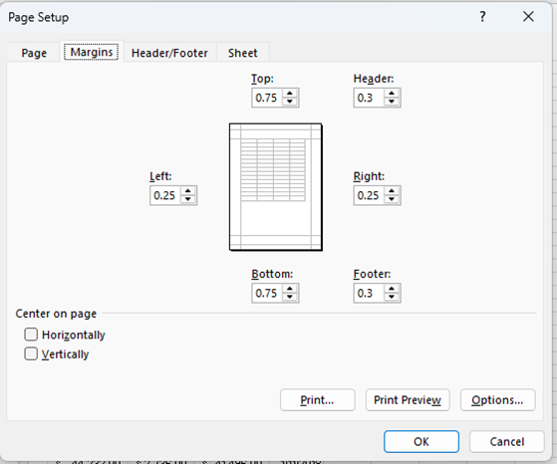
Setting Margins and Orientation
Custom Margins

Slide 12
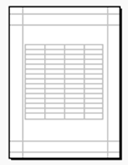

Setting Margins and Orientation
Custom Margins

Slide 13
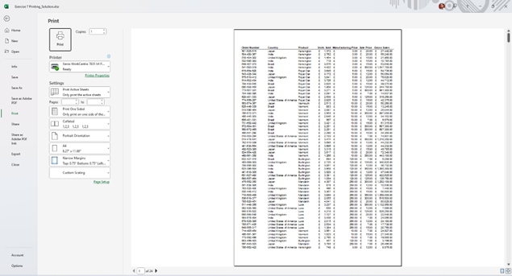
Setting Margins and Orientation
Print Preview

Slide 14
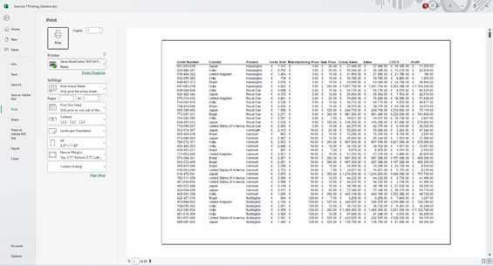
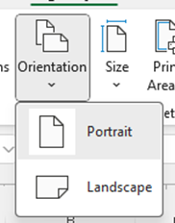
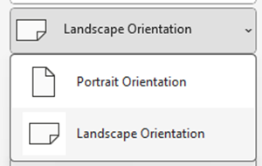
Setting Margins and Orientation
Orientation

Slide 15
Excel
Training
for Beginners
SAID FAWZY
Setting and Clearing the Print Area
2

Slide 16
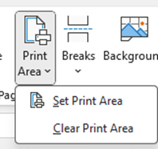

Setting and Clearing the Print Area
Print Area

Slide 17
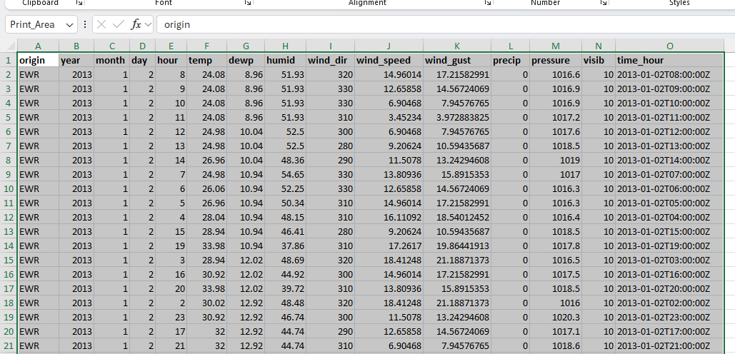
Setting and Clearing the Print Area
Print Area

Slide 18
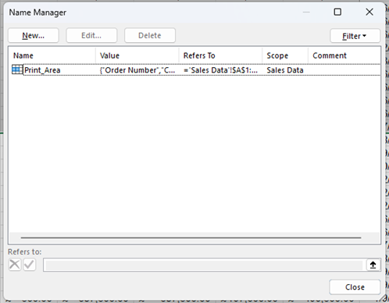
Setting and Clearing the Print Area
Print Area

Slide 19
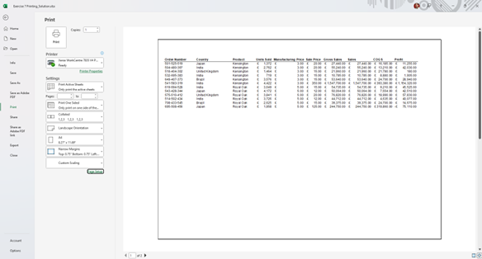
Setting and Clearing the Print Area
Print Area

Slide 20
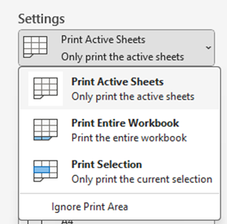
Setting and Clearing the Print Area
Using Print Setting Options

Slide 21
Excel
Training
for Beginners
SAID FAWZY
3
Inserting Page Breaks

Slide 22
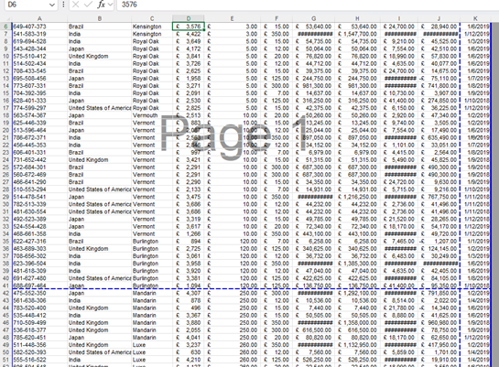
Inserting Page Breaks
Page Break Preview

Slide 23
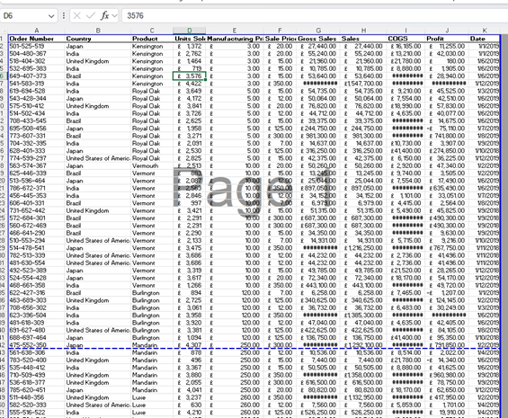
Inserting Page Breaks
Page Break Preview

Slide 24
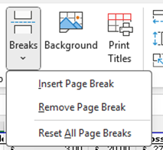
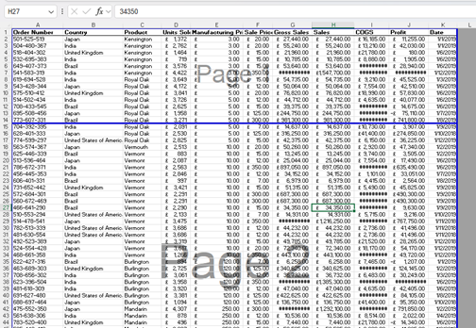
Inserting Page Breaks
Add a Manual Horizontal Page Break

Slide 25
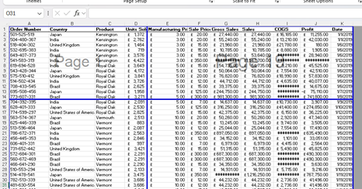
Inserting Page Breaks
Insert Manual Vertical Page Break

Slide 26
Excel
Training
for Beginners
SAID FAWZY
4
Print Titles and a Background

Slide 27
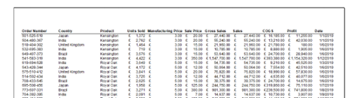
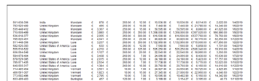

Print Titles and a Background
Repeated Headers

Slide 28
Print Titles and a Background
Repeated Headers

Slide 29
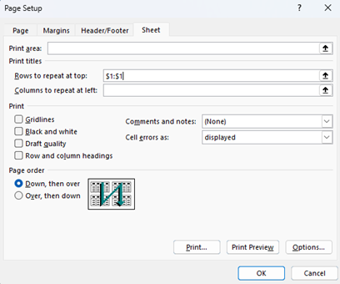
Print Titles and a Background
Repeated Headers

Slide 30
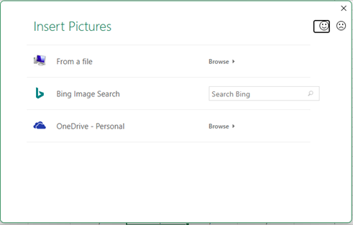
Print Titles and a Background
Add Background

Slide 31
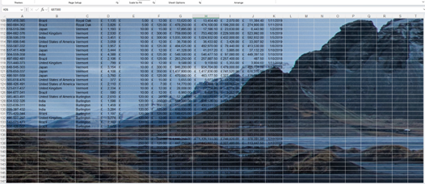
Print Titles and a Background
Add Background

Slide 32
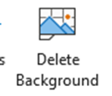
Print Titles and a Background
Add Background

Slide 33
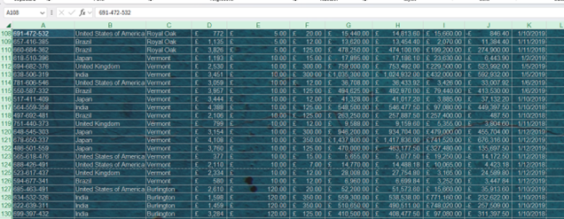
Print Titles and a Background
Add Background

Slide 34
Excel
Training
for Beginners
SAID FAWZY
5
Headers and Footers

Slide 35
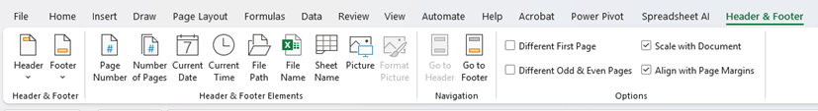
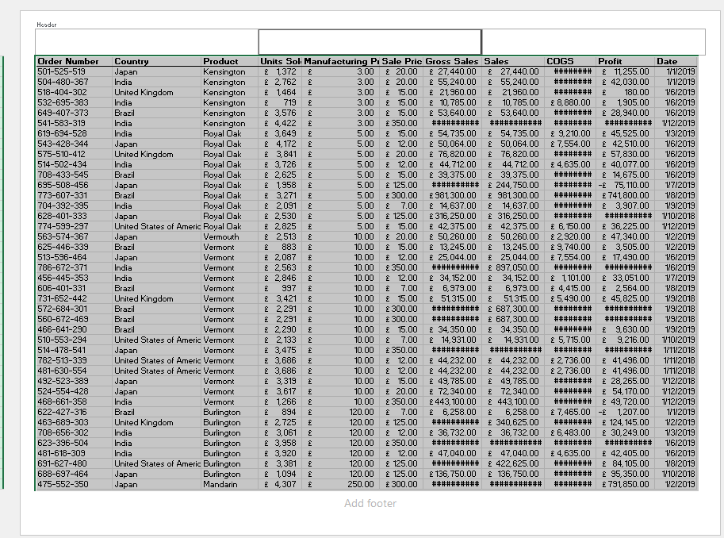
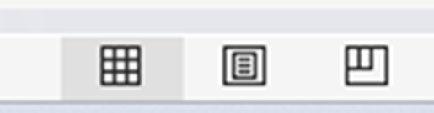
Headers and Footers
Page layout View

Slide 36
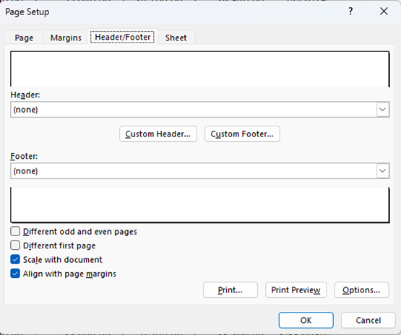

Headers and Footers
Using Page Setup Dialogue box

Slide 37
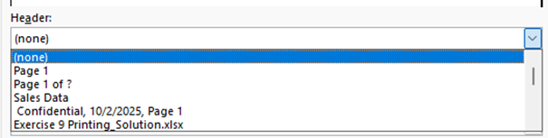
Headers and Footers
Using Page Setup Dialogue box

Slide 38
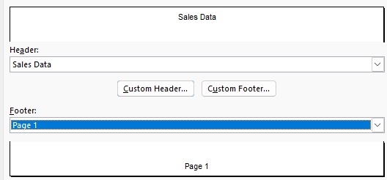
Headers and Footers
Using Page Setup Dialogue box

Slide 39
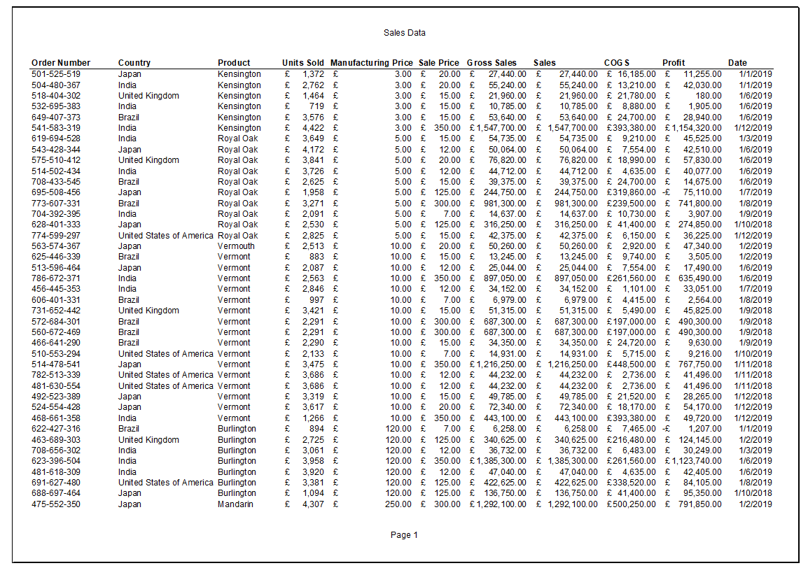
Headers and Footers
Using Page Setup Dialogue box

Slide 40
Headers and Footers
Custom Header and Footer

Slide 41
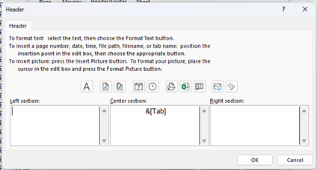

Headers and Footers
Custom Header and Footer

Slide 42
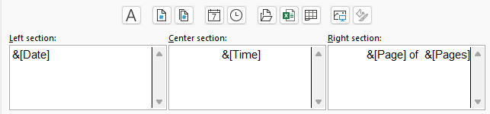
Headers and Footers
Custom Header and Footer

Slide 43
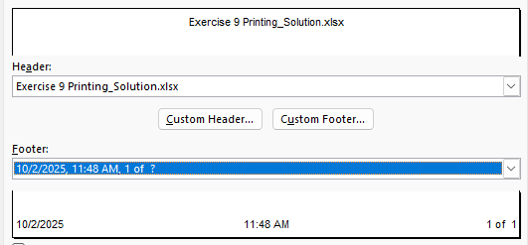
Headers and Footers
Custom Header and Footer

Slide 44
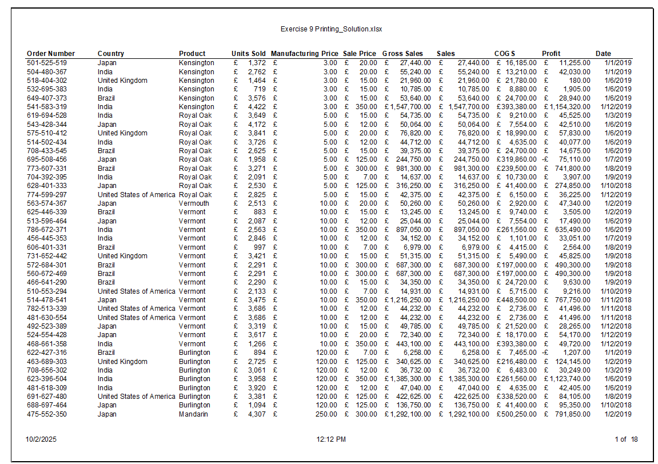
Headers and Footers
Custom Header and Footer

Slide 45
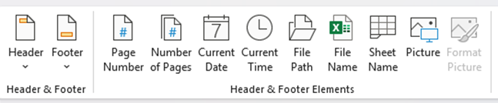
Headers and Footers
Page Layout View

Slide 46
Excel
Training
for Beginners
SAID FAWZY
6
Printing

Slide 47
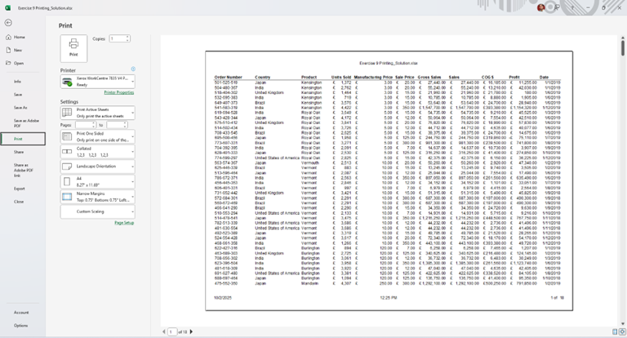
Printing
a. File ➔ Print.

Slide 48
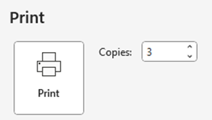
Printing
Print

Slide 49
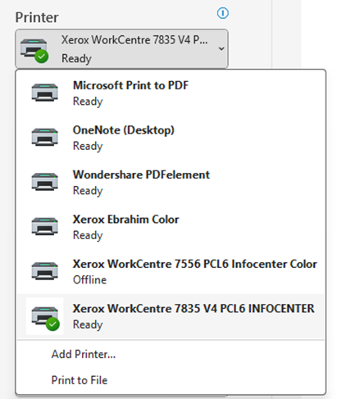
Printing
Select Printer

Slide 50
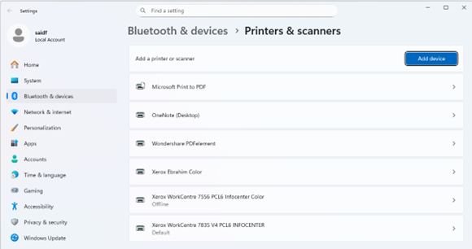
Printing
Add Printer

Slide 51
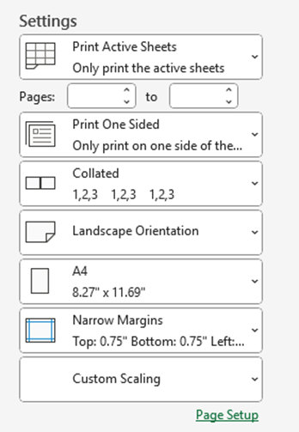
Printing
Print Settings

Slide 52
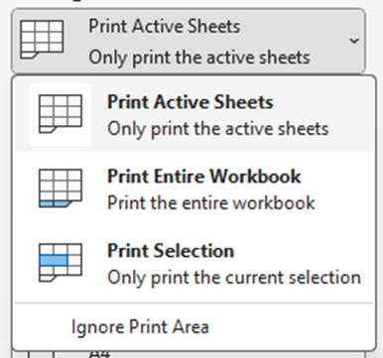
Printing
What to Print

Slide 53

Printing
Pages to Print

Slide 54
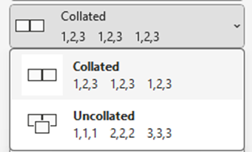
Printing
Collate Copies

Slide 55
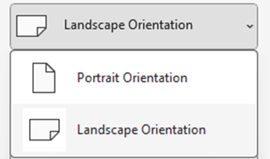
Printing
Orientation

Slide 56
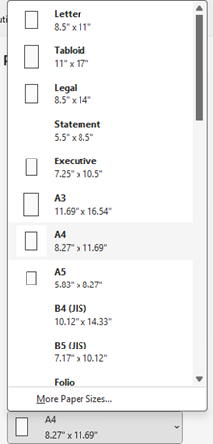
Printing
Paper Size

Slide 57
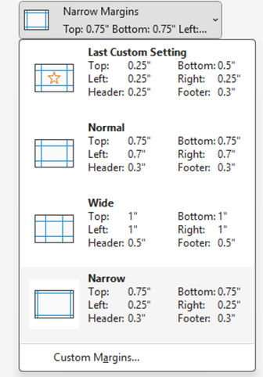
Printing
Margins

Slide 58

Printing
Print Scaling

Slide 59

Printing
Print Scaling

Slide 60

Printing
Print Scaling

Slide 61

Printing
Print to PDF

Slide 62

Printing
Print to PDF

Slide 63

Printing
Save As PDF

Slide 64

Printing
Save As PDF

Slide 65
Excel
Training
for Beginners
SAID FAWZY
Exam 9
Printing Worksheets

Slide 66
Exam 9: Printing Worksheets

Slide 67
Exam 9: Printing Worksheets
Headers and Footers
Add a header to the workbook that displays the workbook name.
Add a footer to the workbook that displays the date and the page number.

Slide 68



